Slide 1
Attention Is All You Need
Mikhail Yurushkin

Slide 2
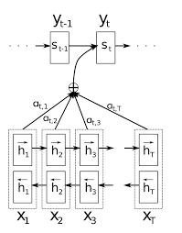
Recap: Attention (Dzmitry Bahdanau, 2014)
It’s used with traditional LSTM/RNN layers.
Helps to process long input sequences.
Strongly sequential. Can’t be used for parallel processing of input words.
Is it possible to fix this issue?

Slide 3
CNN’based SOTA
https://arxiv.org/abs/1706.03762
Convolutional Sequence to Sequence Learning (Facebook AI, 2017)
Fully convolutional and parallel approach
Close input elements interact at lower layers while distant interacts at higher layers
Positional embeddings
Multi-step attention
but:
The calculations number grows with the distance between those positions :(

Slide 4
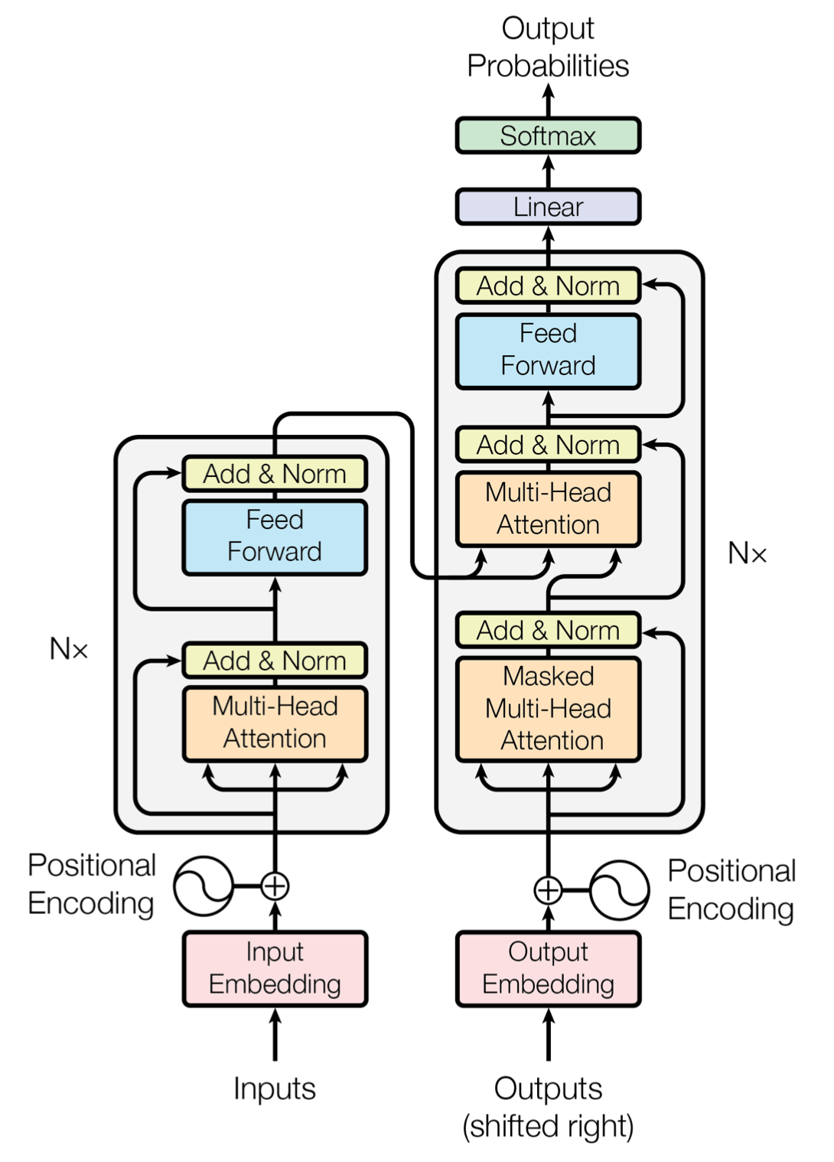
And now smth completely different: Transformer
Not a traditional RNN/CNN!
Attention Is All You Need (Google, 2017)
https://arxiv.org/abs/1706.03762
Self-attention - no extra information is coming from outside.
Transformer captures context of any length with constant complexity

Slide 5
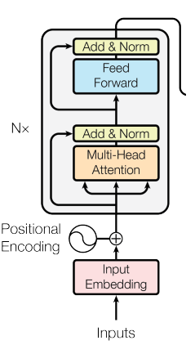
Encoder
Every word is processed in parallel
Usage of short-cut connections
Multi-head attention
Input shape is equal to output shape. Stacking is performed 6 times.

Slide 6
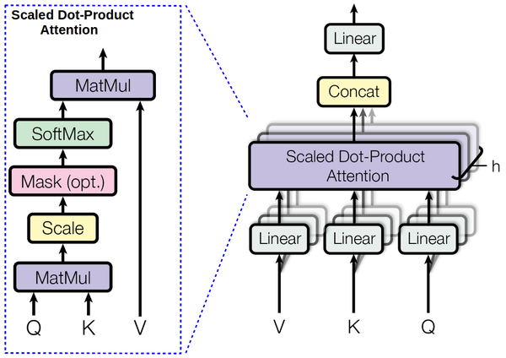
Multi-head attention
Every word is connected with other words via attention
All attention layers learn particular features of word (grammatical/syntactic/etc features)
def attention(Q, K, V): num = np.dot(Q, K.T) denum = np.sqrt(K.shape[0]) return np.dot(softmax(num / denum), V)

Slide 7
Self-attention vs RNN/CNN
Minimize total computational complexity per layer
Maximize amount of parallelizable computations
Minimize maximum path length between any two input and output positions in network composed of the different layer types

Slide 9
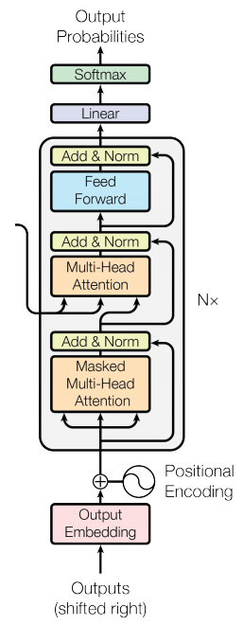
Decoder
Still sequential :(
Multi-head attention for previous decoded words
multi-head attention for input words
Input shape is equal to output shape. Stacking is performed 6 times.
Output - softmax + sampling

Slide 10
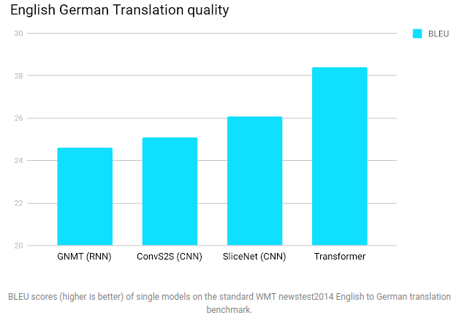

Slide 11
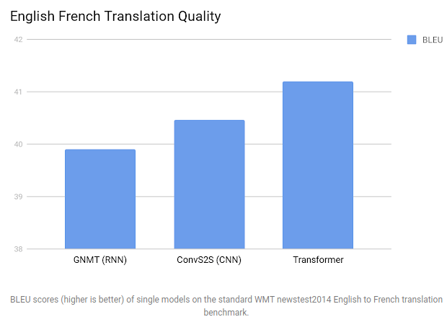

Slide 12
Theories without proves
Introduction of multi-head attention helps to capture contexts of different length with constant complexity.
Enables parallelization
Killer of CNN/RNN?! Self-attention rocks!
Transformer is implemented in Yandex.Translate

